Slide 1
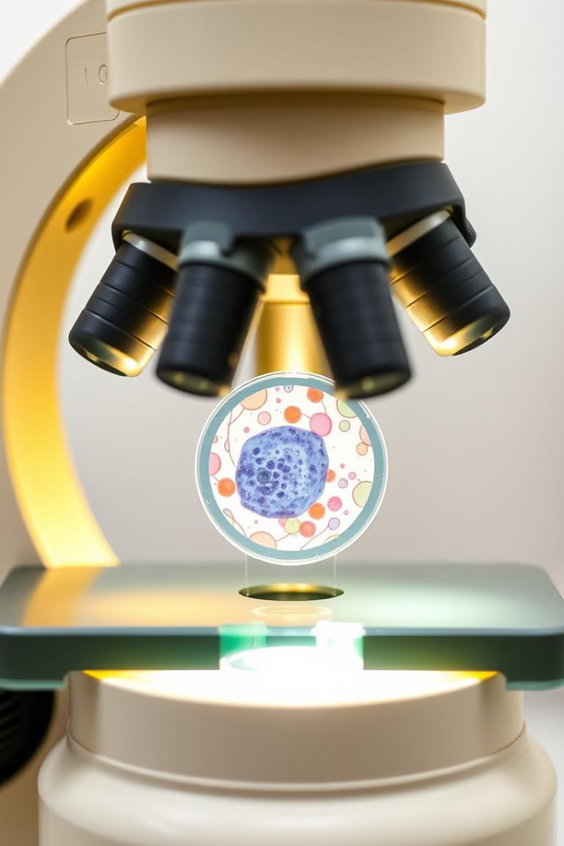
Cancer Cell Classification using Deep Learning
-Bug Hunters| Techathon_672

Slide 2
Problem Statement
Cancer Diagnosis
Deep Learning Model
Accurate cancer diagnosis is critical for effective treatment. Identifying cancerous cells in microscopic images assists doctors in confirming the presence of cancer.
Our project focuses on developing a deep learning model to classify cells as cancerous or non-cancerous, helping medical professionals make informed decisions.

Slide 3
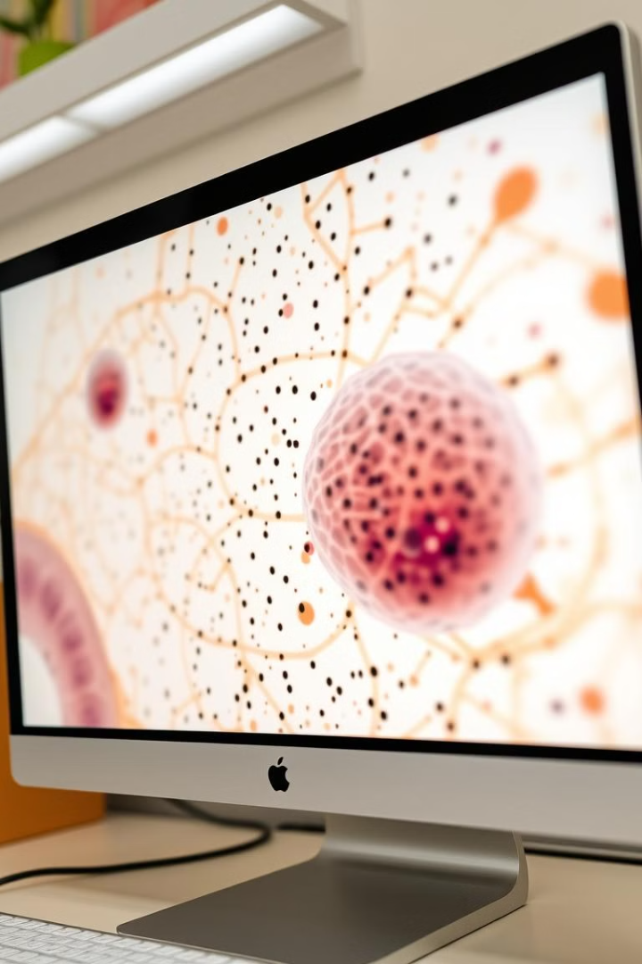
Our Solution
1
Our deep learning model analyzes microscopic images of cells.
2
It predicts whether a cell is cancerous or not.
3
This aids doctors in quickly interpreting test results.

Slide 4
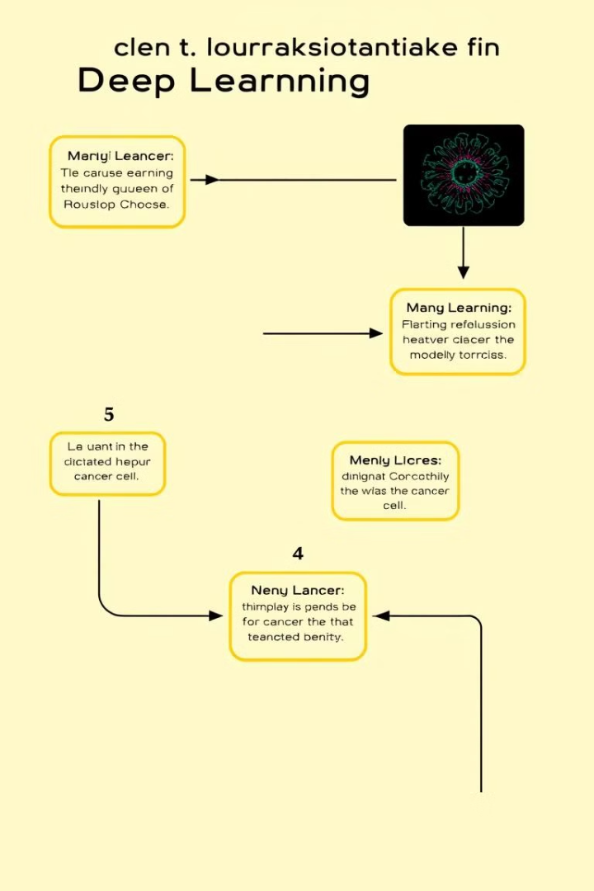
How It Works
1
1. Collect and preprocess microscopic cell images.
2
2. Train a deep learning model using labeled datasets.
3
3. The model predicts if the given cell is cancerous or not.
4
4. The results assist medical professionals in decision-making.

Slide 5
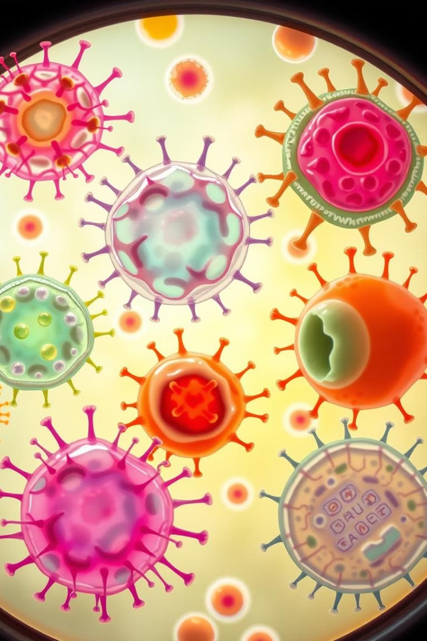
Dataset Used
UCSB Bio-Segmentation: This dataset provides various labeled cell images.
Kaggle Blood Cell Dataset: A collection of blood cell images for training models.
TCGA Dataset: A comprehensive dataset of various types of cancer cells.

Slide 6
Deep Learning Model
Convolutional Neural Networks (CNN)
Input
Processing
Output
Microscopic cell images are fed as input to the model.
Deep learning extracts features from the images.
The model classifies the cell as cancerous or non-cancerous, and can even segment the cell image.
We utilize CNNs, well-suited for image classification tasks.

Slide 7
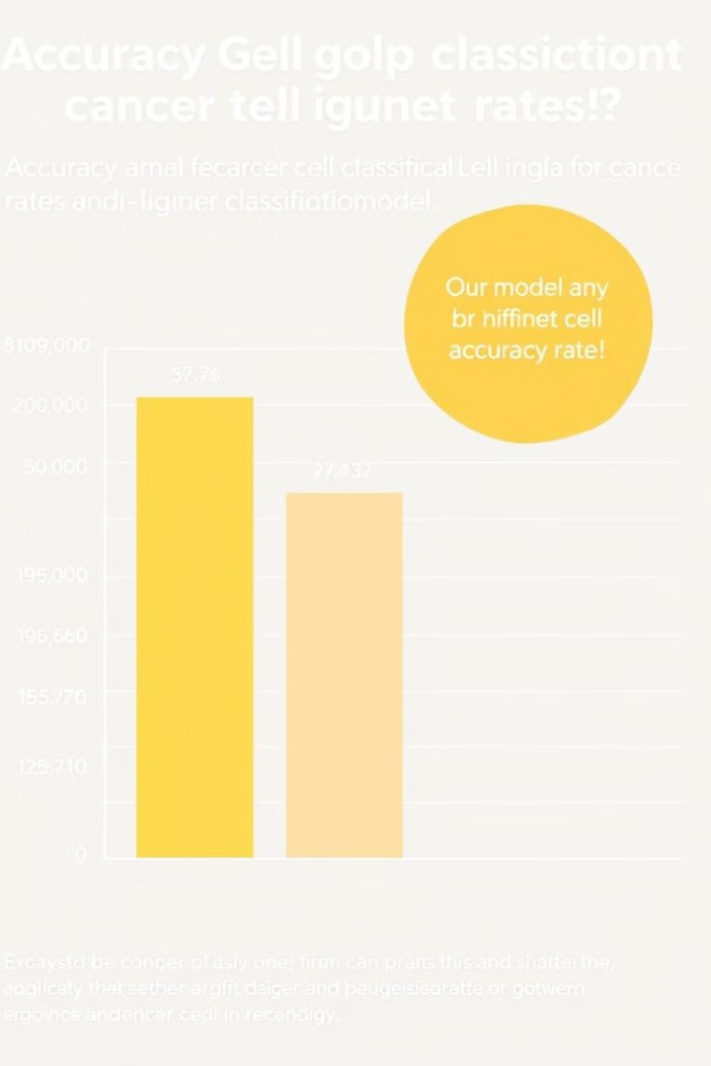
Results & Accuracy
81%
reliable
Accuracy
Classification
Our model achieves high accuracy in predicting cancer presence.
Our model reliably classifies cancerous cells.
robust
Performance
It demonstrates robust performance on new test images.

Slide 8
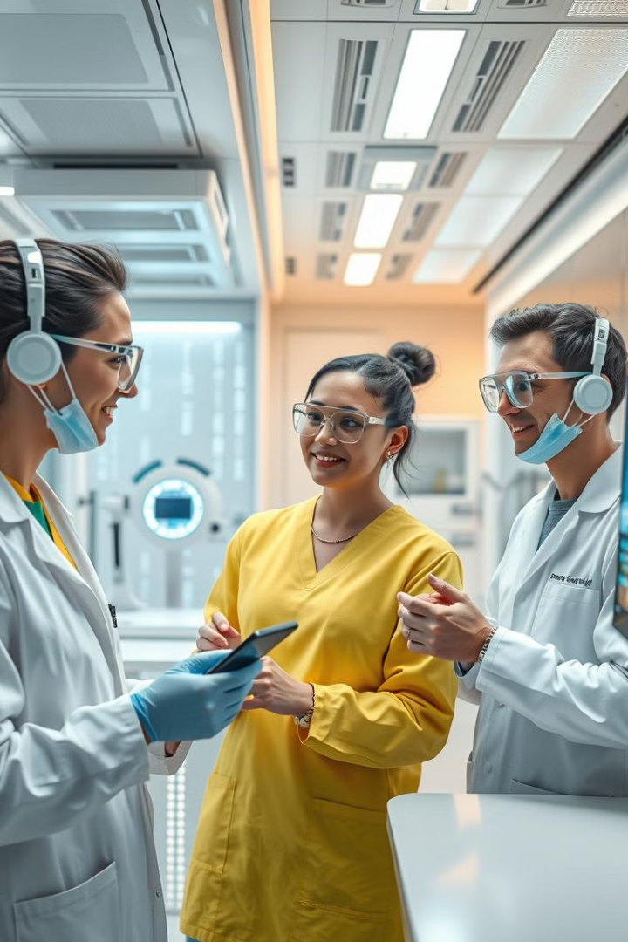




Future Scope
1. Train on larger datasets to further improve model accuracy.
2. Expand the model to classify different types of cancer.
3. Deploy as a mobile or web application for user-friendly access.
4. Integrate the model in real-time medical analysis for immediate results.

Slide 9
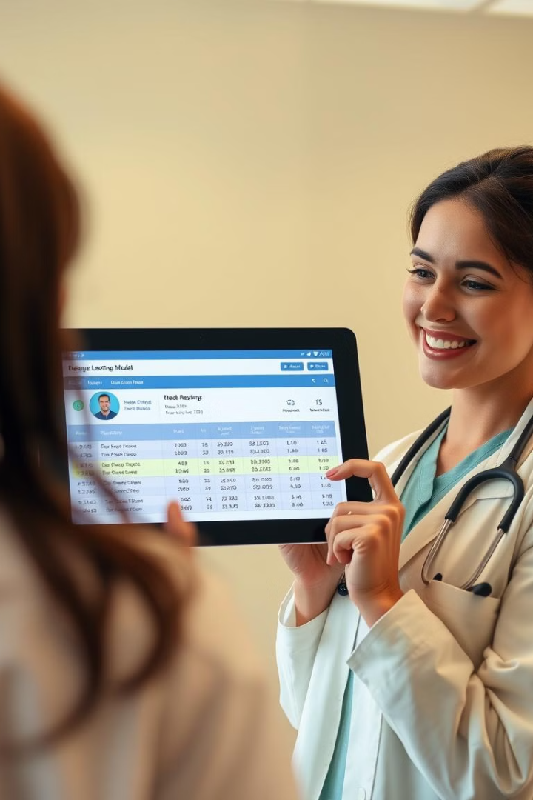
Conclusion
Our deep learning model aids in detecting cancerous cells from microscopic images, assisting doctors in diagnosis. By further improving accuracy and accessibility, we aim to make medical analysis more efficient and readily available.

